Slide 1


Starting a Shell, Create your first script - Hello World

Slide 2
Starting a Shell,
Create your first script - Hello World

Slide 3
Shell Scripts are written using text editors. On your Linux system, open a text editor program, open a new file to begin typing a shell script or shell programming, then give the shell permission to execute your shell script and put your script at the location from where the shell can find it.

Slide 4
Let us understand the steps in creating a Shell Script:
Create a file using a vi editor (or any other editor). Name script file with extension .sh
Start the script with #! /bin/sh
Write some code.
Save the script file as filename.sh
For executing the script type bash filename.sh
“#!” is an operator called shebang which directs the script to the interpreter‟s location. So, if we use”#!
/bin/sh” the script gets directed to the bourne-shell.

Slide 5
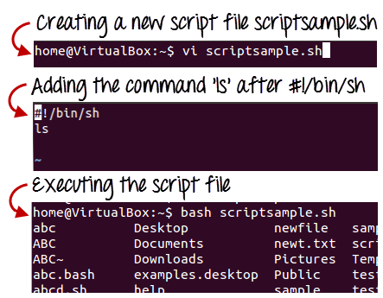
#!/bin/sh
ls
Let‟s see the steps to create Shell Script Programs in Linux/Unix –

Slide 6
Command ls is executed when we execute the script sample.sh file.
Adding shell comments
Commenting is important in any program. In Shell programming, the syntax to add a comment is
#comment

Slide 7
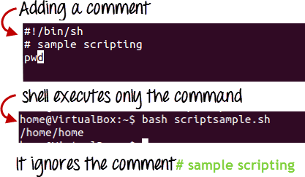
Let us understand this with an example.

Slide 8
Variables store data in the form of characters and numbers. Similarly, Shell variables are used to store information and they can be by the shell only.
For example, the following creates a shell variable and then prints it:
variable ="Hello“
echo $variable
Below is a small script that will use a variable.
#!/bin/sh
echo "what is your name?“
read name
echo "How do you do, $name?“
read remark
echo "I am $remark too!"

Slide 9
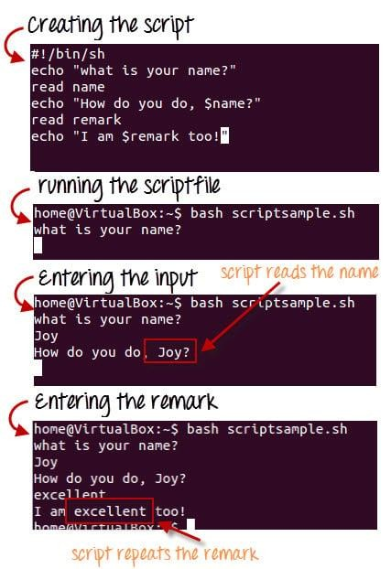
Let‟s understand, the steps to create and execute the script

Slide 10
In this shell script article we are going to learn:
shell script to print hello world in linux
important linux commands like vi, echo, chmod required to print hello world in linux
Shell Script is a command-based language i.e list of commands given by the user and it executes one by one. File manipulation, program execution, and printing text are typical operations performed by it.

Slide 11
At first clear your screen to have clean and fresh terminal.
You can either directly print Hello World or store it in a variable which is given by user and then prints it.
You should save the program and give directory where your code will be saved.
Use the execution command to give permission to execute code otherwise it will show error - permission denied or not given.
Coder should use '#' to make a comment just like we use '//' in C, C++ and Java to make comments.

Slide 12
Given below is hello world program in shell script:
#!/bin/sh
# This is a comment! echo "Hello World“
# after save the code use chmod 755 file_name.
#insead of 755, you can use +x means to give permission for execution.
#or you can directly use bash file_name

Slide 13
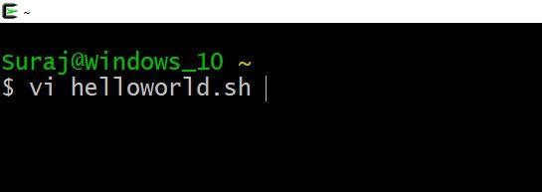
If you are using Linux os, you can directly goto terminal and run.
hello world in shell script compile steps
First create a file as we do in hard disk or you can directly create file via terminal. I use vi command to 'vi helloworld.sh' where helloworld.sh is file name. Once typed press enter.

Slide 14
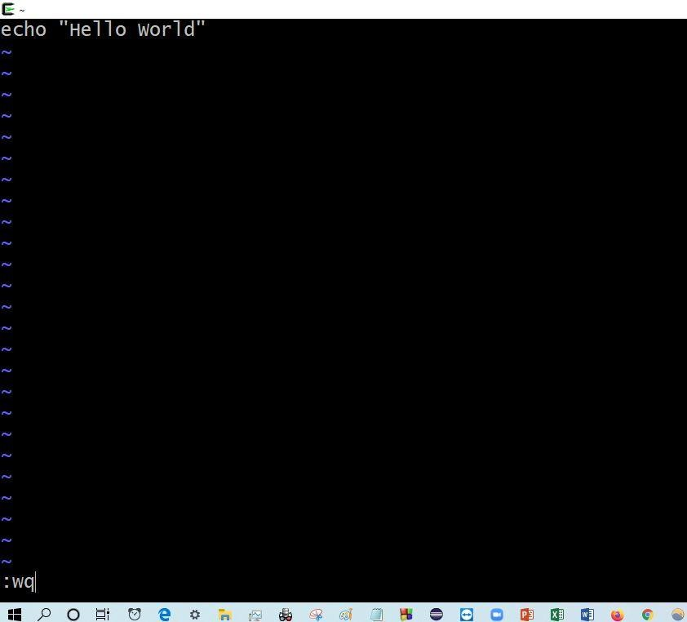
After above step, press i to insert your code and then type your code. After writing, press esc key and then type ':wq' to save and quit.

Slide 15
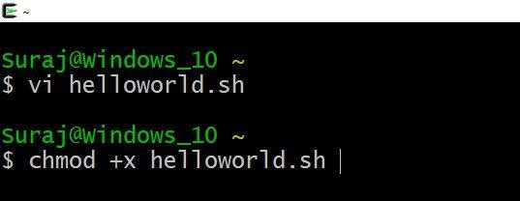
Now its time to execute our program.
Type chmod +x file_name. Here filename is helloworld.sh. And then press enter.

Slide 16
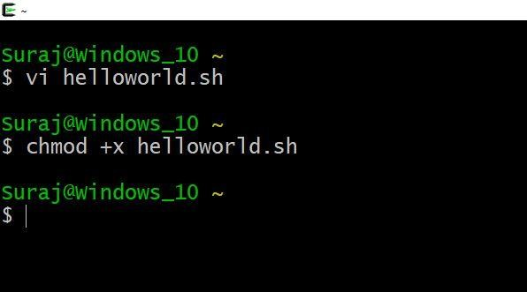
After you press enter, your cursor will come on the next line as shown in below image.

Slide 17
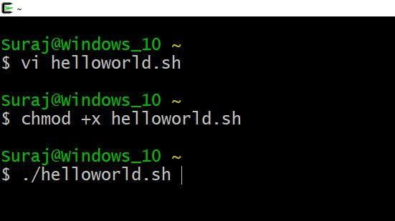
Now type ./file_name and then enter

Slide 18
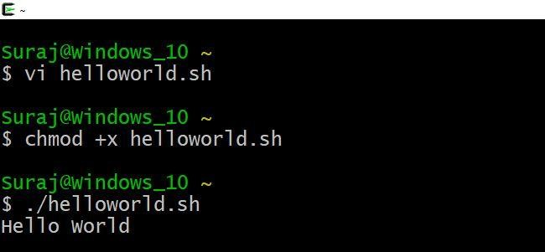
You can see below image that hello world is printed successfully in shell script.

Slide 19
This completes the steps on hello world in shell script. Explanation to hello world in shell script
Given below is hello world program in shell script
explanation:
'echo' is used to print helloworld.
'vi' is used to create file.
'chmod +x file_name' or 'chmod 755 file_name' is used to give permission for execution.
'./file_name' is used to execute program.

Slide 20
Exercise
Write a shell Script to print
Todays date,
your current directory,
all the content present inside it.
Write a small shell script to wise your several friends on there birthdays.
Hint: take name, adjective, age, date as a variable, and try to write 3-4 line of a message.

Slide 21
https://linuxhandbook.com/shebang/

Slide 22


